Slide 1

Literature Review: Endless Runner Genre
Presented by
Tashfiq Mahmud Niloy
Tirana Mahbub Meem
Ihtishamul Haq Shimanto
Tamanna Akter Mou

Slide 2
Objectives & Scope
•Summarize studies and sources on endless runner games.
Explain why the genre emerged and its key mechanics.
Identify popular titles and their influence.
Evaluate current popularity and market trends.

Slide 3
What is an Endless Runner?
Player moves endlessly until failure or obstacle.
Simple controls (tap/swipe) and infinite level design
Focus on score, distance, and quick sessions.

Slide 4


Origins & Early Examples
Early roots in Doodle Jump (2009).
Genre grew with the rise of smartphones.
Canabalt (2009) popularized one-tap endless gameplay.

Slide 5


Why It Was Made
Designed for mobile touch controls — simple to play.
Fit casual gaming trends and short attention spans
Allowed easy monetization via ads/in-app purchases.
Procedural levels reduced design workload.

Slide 6

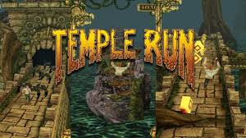

Popular Games
Canabalt (2009) – pioneer indie game.
Temple Run (2011) – huge cultural success.
Subway Surfers (2012) – over 3 billion downloads.
Jetpack Joyride, Flappy Bird, Alto’s Adventure, Crossy Road, Sonic Dash.

Slide 7
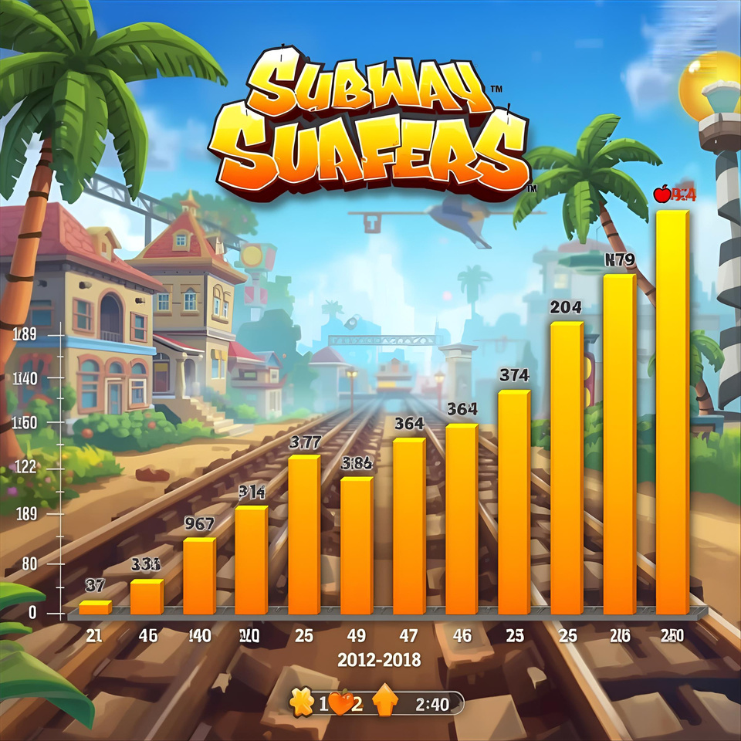
Evidence & Market Impact
Temple Run and Subway Surfers reached billions of plays/downloads.
Subway Surfers still ranks among top mobile games.
Market reports show steady growth for mobile runner games.

Slide 8
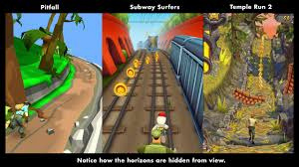
Criticisms & Limitations
Saturation of copycat titles.
Repetitive gameplay and lack of innovation.
Ads and paywalls can frustrate players.

Slide 9
Is It Still Popular?
Yes — still strong among casual mobile gamers.
Classic titles continue updates and downloads.
Genre now a stable niche, though less trendy than 2010s.

Slide 10
Research Gaps & Future Trends
Need studies on player retention vs. monetization.
Explore procedural design’s effect on engagement.
Potential in hybrid genres (runner + roguelite, AR/VR).

Slide 11
Conclusion
Born from mobile and casual gaming needs.
Created cultural hits and defined mobile design.
Still alive but needs innovation to stay relevant.

Slide 12
References
Wikipedia – Endless Runner
The New Yorker – Don’t Stop: The Game That Conquered Smartphones
TIME & Tech news on Temple Run and Subway Surfers
DataIntelo – Mobile Runner Game Market Report

Slide 13
Thank You for your Attention

